Slide 1

SATR BOOK CLUB CAMPAIGN
Want Exchange?

Slide 2
Our team
Hagar Elbanna
Content Creator
Mai Waleed
leader
Designing & Marketing analysis
Rahma Mahmoud
designer & customer insight specialist
Rana Ali
Content Creator
Client relationship manager
Sarah meklad
Our supervisor
Ibrahim Elsayed
Designer & content creator

Slide 3


ABOUT SATR
Established in 2023 and primarily serving the Suez region in Egypt, Satr is a book exchange platform dedicated to fostering a love for reading and knowledge sharing.
Through Satr, readers can easily exchange books, discover new perspectives, and connect with a community that values lifelong learning and the joy of storytelling.

Slide 4



























Business Model
Key Partners
Key Activities
Value Proposition
Customer Relationships
Customer Segments
Social Media Management
Affordability
Event-Driven
Local Cafes
Avid Readers
User Support Via Whatsapp
Community Building
Local Workspaces
Managing Events and
Meetups
Convenience
Suez Community
Secured
Exchange Process
Key Resources
Channels
Universities
Community
Facebook, Instagram,
TikTok, Whatsapp
Social Media Presence
Google Site Website
Book Collectors
Delivery Services
Google Site Website
Sustainability
Events & Meetups
Cost Structure
Competitors
Revenue Streams
Attending Events Fees
Delivery
Coordination
Innovate Egypt
Event Materials and Décor
Transactions Fees

Slide 5

Strengths
Weaknesses
Established Platform: SATR already has a user base through the book exchange platform, providing a ready-made community.
Community Building: The book club strengthens bonds among readers, deepening engagement with the platform.
Unique Offerings: Combines book exchanges with interactive in-person discussions, giving SATR an edge over purely online communities.
Personal Connections: In-person
events foster deeper connections, which can increase platform loyalty.
Limited Reach: Currently limited to Suez or specific locations, which might restrict growth potential.
Resource-Intensive: Organizing in-person events requires significant time, effort, and logistical coordination.
Low Digital Engagement: If not supported by strong online interaction, engagement with the platform might wane between events.
SWOT
Opportunities
Personal Connections: In-person events foster deeper connections, which can increase platform loyalty.
Partnerships: Potential for collaborations with local bookstores, libraries, and cafes to co-host or sponsor events.
Growing Book Culture: Capitalize on the increasing popularity of book clubs, both online and offline, and the trend toward niche, community-driven experiences.
Threats
Competition from Online Platforms: Competing with larger, established online book clubs and communities that provide virtual options.
Event Fatigue: If the same format is repeated too often, members might lose interest and attendance could drop.
Uncertainty of Physical Events: In-person events are vulnerable to restrictions from health concerns (pandemics, etc.) or other logistical issues.

Slide 6
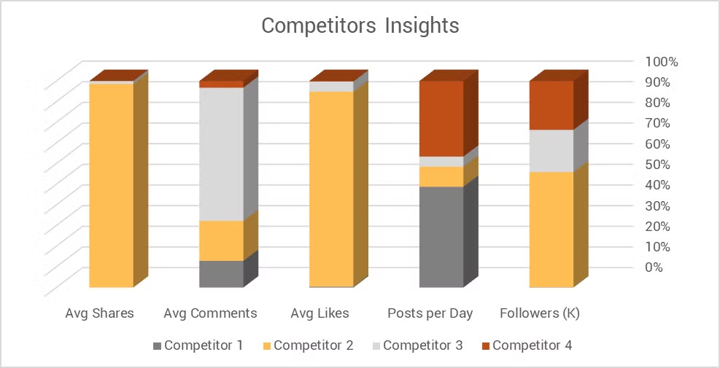

Slide 7
Competitor analysis: Facebook
page name | Acropolis | Mahel kotob
likes |  | 65k
followers |  | 204 likes
reviews | 316 reviews - 70% positive - 20% negative reviews - 10 % neutral
about section | no details except for the contact information | location and contact information
posting regularly | yes multiple times a day | yes
posting frequency | average if 20 posts a day | one or two posts a day
average likes per post | average 3-5 likes per post | 68 likes per post
average comments per post | one or two comments | 10 likes per post
average shares | almost no shares | 4 per post
type of content | reviews and description of books | engagement and promotional and engaging
tone of voice | informative and enthusiastic | playful and engaging
comments on replies | replies are professional and fast | doesn't reply to comments only interact with them
designs | there is no designs except for the logo | there is no designs
identity | consistent identity | constant funny identity
strengths | straight forward to the point posts and consistent posting with good photography of the books | they know how to engage their audience and how to promote for their books with simple posts
weaknesses | no diversity in the content and no engaging content | there is no engagement wirh customers in the comments and no diversity in content and the branding is not strong

Slide 8
Competitor analysis: Instagram
page name | Kotoblak | Book mart
followers | 177k | 306
post numbers | 886 | 120
pinned stories | they have books pinned | quotes and books
pinned posts | they have books that are best sellers | non
posting frequency | from 3 to 5 a day | 2 per day
average likes | average of 1,300 likes per post | 3 likes per post
average shares | 284 shares per post | no shares
average comments | 3 comments per post | non
paid content | no | no comments
types of content | informative and promotional | promotional and informative
tone of voice | persuasive and informative | persuasive and informative
CTA | go to whatsapp
comments on replies | doesn't reply to comments | no comments
designs | non | non
identity |  | informative
strengths | they post content that people want to see | posting regularly
weaknesses | the content is not engaging | no reels and no trends content

Slide 9
Competitor analysis: TikTok
page name | smsma book store | aseer elkotob
followers | 19.7 k | 269.9 k
description | all original books | نضيف حياة جديدة للكتب
links | link to a website and insta | link to their website
playlist | offers and unboxing and saudi orders and terror books | non
pinned reels | why to but fom them | their most viral videos
posting frequency | 8 posts a day | one post per day
average likes | 180 likes per post | 29 perpost
average views | 3200 views per post | 1.3 k
average shares | 33 shares per post | one per post
average saves | 22 shares per post | about 4 saves per post
type of content | mainly promotional | promotional
tone of voice | trust worthy and authentic | persuasive
CTA
replies to comments | professional and engaging comments | no replies
designs | non | non
identity | authentic warm identity | authentic
strengths | they have loyal customers and good influencer marketing posts | they have stong and well established social media presence
weakenesses | no diversity in content and the photography quality not good | no diversity in content and no engaging with the audiance

Slide 10
SATR social media analysis
channel | facebook | instagram | tiktok
followers | 492 | 584 | 65
about section / description | location and insta and tiktok accounts and website link | explain the service and their website | هنا حيث يتم انقاذ الكتب المستعملة
posting frequency | 4 per week | about 3 or 4 per week | not consistent
average likes | 4 per post | 14 likes per post | 10 per post
average comments | no comments | no comments | non
average shares |  | 2 shares per post | non
average saves | …….. | ……….. | about one per post
type of content | promotional and educational and branding | branding and promotional and educational | promotional and educational
tone of voice | enthusiastic and persuasive | informative and friendly and enthusiastic | informative and frirndly
CTA | join our reading circle | join our reading circle | ……
replies on comments | non | no replies | non
designs | yes with consistent feel and look | not consistent feel and look | non
identity | friendly and educational | consistent friendly and enthusiastic identity | not very clear
strengths | diversity of content to an extent consistent tone of voice | sharing variety of content and consistent tone of voice | sharing variable types of content consistent tone of voice
weakness | no engaging content and the need to publish more | need to share more frequently and their designs need to be more consistent | no consistent posting and no content made specifically for tiktok
insta pinned stories | ………… | quotes and feedbacks and partnership and satr team and questions
pinned posts / reels |  | why to attend their reading circle and their book club video | video saying who they are
average views in tiktok |  | …………… | 400 views per post
playlist in tiktok |  | …………. | non

Slide 11

Goals/Aspirations
Meet Our Audience
Values & Beliefs
Behavioral Information
Primary goal: He seeks to develop himself and educate his mind by reading different types of books, especially books related to France, due to their great influence on his field of work in translating the French language.
Secondary goal: He aspires to succeed in his field of work and to have the opportunity to travel abroad.
Knowledge, sustainability, and community, Reading is essential for personal growth and development
Buying Behavior: Frequents bookstores, libraries, and online book retailers.
Product Usage: He has a passion for reading and participates in quiet evening and participates in book clubs.
Technology Usage: He uses social media to follow new books, news about writers, where books are available, and everything related to places where readers meet.
Lifestyle
Omar
Enjoys quiet evenings at home, often reading for pleasure.
Age : 25 years old Location : Suez Gender : Male
Education : Graduate of the Faculty of Arts
Profession : French translator Marital Status : Single Income : 5000 EGP
Children: 0
Challenges/Pain Points
Motivations & Influences
He has difficulty finding places where books are located and where readers meet, and he also has difficulty finding the books he needs as they are not available all the time.they need solutions for.
Motivators: Passion for books and a desire to support sustainable practices.
Influences: He trusts opinions (friends, family, experts, social media) for information
Media Consumption: He prefers (blogs, podcasts, social media, news outlets, e-reading clubs).
Personality Traits
Curious, thoughtful, sympathetic, sociable, cultured and interested in reading historical books.

Slide 12
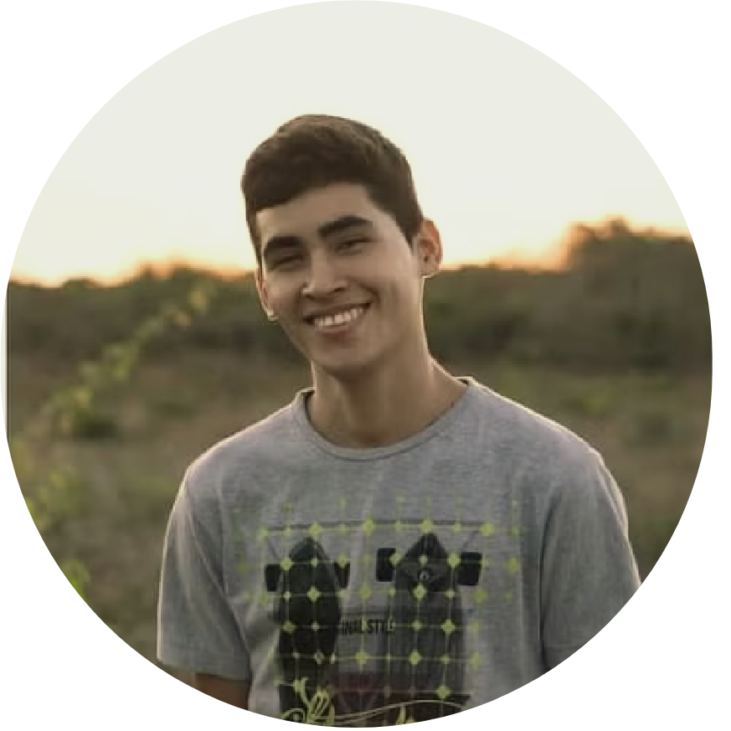
Goals/Aspirations
Meet Our Audience
Personality Traits
Behavioral Information
Primary Goal: To balance the demands of medical school with a lifelong passion for reading.
Secondary Goals: Discover new authors and genres: Expand their literary horizons beyond medical textbooks.
Connect with like-minded readers: Build a community of individuals who share their love of books.
Save money on textbooks and other reading
materials: Find affordable alternatives to expensive academic texts.
Extroverted, creative, and tech-savvy, interested in new experiences and adventures.
Buying Behavior: He follows book reviews and makes a purchase decision based on people's good opinions.
Product Usage: Reduce stress and improve mental well-being he use reading as a form of relaxation and escape from the pressures of medical school.
Technology Usage: Digitally savvy, active on social media platforms.
Values & Beliefs
He believes that social media can be a powerful tool for connecting with others and sharing ideas.
Ahmed
Age : 20 years old
Location : Suez
Gender : Male
Education : Student at faculty of medicine
Marital Status : Single
Children : 0
Lifestyle
Enjoys spending time with friends, attending concerts, and exploring new places
Motivations & Influences
Motivators: Discovering new books, connecting with like-minded people, and sharing their love of reading online.
Influences: He trusts the opinions of his reader friends, follows influencers on social media and gets information from them.
Media Consumption: Preferred media channels (blogs, podcasts, social media).
Challenges/Pain Points
He struggles to obtain books because of their steep prices and wishes to find them at affordable rates that fit his budget.
He struggles to identify the right books for himself and requires ample time to select and determine which one to read.

Slide 13
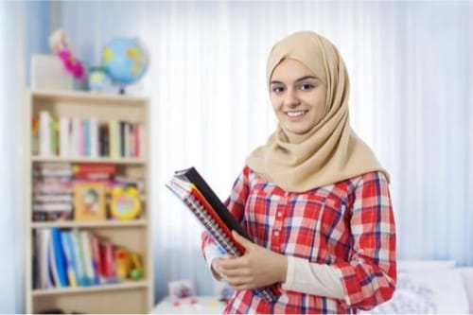
Goals/Aspirations
Meet Our Audience
Values & Beliefs
Behavioral Information
Primary goal : Intellectual Growth to expand knowledge and understanding through reading.
Secondary Goals: To expand their reading horizons by discovering new authors and genres.
To participate in meaningful discussions about literature and share insights with others.
Simplicity, authenticity, and mental health.
Technology should be used mindfully and in moderation.
Buying Behavior: She looks for book exchange platforms that offer a diverse selection of books and a supportive community.
Values quality and authenticity in books and prefers physical copies over digital formats.
Product Usage: She interested in physical books than electronic ones, and she is also interested in attending reading events or workshops
Technology Usage: Values mental health
and well-being and limits screen time and prioritizes offline activities.
Lifestyle
Hana
Challenges/Pain Points
Minimalist lifestyle, focuses on quality over quantity.
Age : 30 years old
Location : Suez
Gender : Female
Education : Graduate of the Faculty of Education
Profession : Teacher
Marital Status : Married
Income : 4000 EGP
Children : 1
Finding time to read and participate in reading circles amidst their busy teaching schedule.
Overcoming the temptation to rely on electronic devices for entertainment and information.
Connecting with other avid readers who share
their interests and values.
Motivations & Influences
Motivators: Desire to reduce digital distractions and cultivate a more meaningful reading experience..
Influences: She trusts her (family, friends, experts, and writers) to provide her with information.
Media Consumption: Prefer useful video channels related to the field of teaching..
Personality Traits
Contemplative, mindful, focused, good conversationalist, interested in reading circles, has a passion for reading and loves exchanging opinions with others

Slide 14
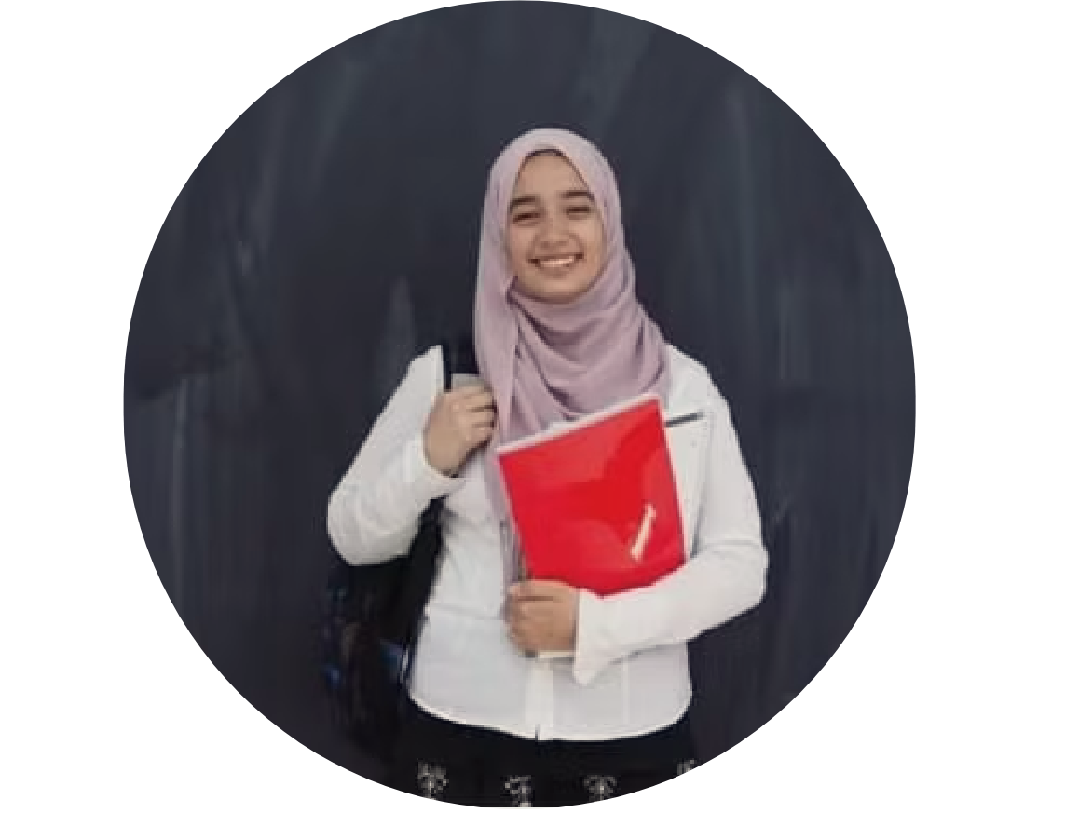
Goals/Aspirations
Meet Our Audience
Values & Beliefs
Behavioral Information
Primary goal : Achieving high grades and excelling in her business studies.
Personal Growth: Expanding her knowledge and understanding of the world through reading.
Social Connection: Building and maintaining strong relationships with friends and family.
Secondary Goals: Saving money on books while
accessing a wide variety of reading material.
Knowledge is Power: Believes in the importance of continuous learning and personal development.
Community and Connection: Values strong relationships with friends, family, and like-minded individuals.
Buying Behavior:
Prioritizes affordable options and discounts on books.
Prefers easy access to a wide selection of books, either online or in-person.
Relies on reviews, word-of-mouth, and social media recommendations when choosing books.
Product Usage: Use it to develop skills, acquire new information, and invest your time in something useful
Technology Usage: Comfortable using online platforms and mobile apps for browsing, purchasing, and sharing books.
Actively participates in book-related communities and forums on platforms like Instagram and Goodreads..
Laila
Lifestyle
Hobbies, interests, and daily activities.
Age : 19 years old
Location Suez
Gender : Female
Education : Student at faculty of Commerce
Marital Status : Single
Challenges/Pain Points
Motivations & Influences
Limited Budget: Managing expenses while purchasing textbooks and other reading materials.
Lack of Access: Difficulty finding specific books or authors, especially in remote locations or specialized genres
Motivators: Desire to expand her horizons and broaden her perspectives
Influences: Friends and Family: Recommendations and suggestions from loved ones.
Book bloggers, influencers, and online communities.
Media Consumption: Preferred media channels (blogs, Instagram, Follow influencer , social media)
Personality Traits
Organized and Efficient: Values planning, time management, and productivity.
Social and Outgoing: Enjoys interacting with others and building connections.

Slide 15
Our campaign :SATR book club

Slide 16

Build a Stronger Community
Encourage in-person interactions around shared love for books. Foster a sense of belonging among SATR members.
Drive Deeper Engagement
Offer opportunities for meaningful conversations. Promote ongoing participation within the SATR platform.
Strengthen SATR’s Brand
Enhance the perception of SATR as a community hub for readers.
Increase user retention through memorable, in-person experiences.
Why Host the Book Club

Slide 17

Expanding SATR’s Community-Driven Approach
SATR connects people through book exchanges.
The book club extends this by fostering in-person connections.
Turning Transactions into Relationships
Encourages members to engage beyond transactions.
Creates deeper bonds through shared literary discussions.
Enriching User Engagement
Enhances engagement by offering a physical space for members to gather and bond over books.
How the Book Club Event Fits into Satr’s Mission
Supporting SATR’s Long-Term Growth
Book Club: Builds loyalty by adding community value and encouraging users to stay active and engaged.

Slide 18
Campaign Objectives
Increase Awareness of the SATR Book Club
Drive Participation in the Book Club Event
Increase Engagement on Social Media
Grow SATR’s Social Media Followers
Increase visibility of SATR and introduce the book club to new potential members who may not have heard of the platform.
Encourage followers and new users to register for the book club event.
Use the book club campaign to spark more activity on SATR’s social media channels and increase overall engagement.
Use the campaign to attract new followers to SATR’s page, leveraging the book club event as a reason to follow.
Key Metric
Key Metric
Key Metric
Key Metric
Aim for at least 40 registrations by the end of the campaign, with a conversion rate of 5-7% from paid ads and organic traffic.
Increase average likes on Instagram posts from 20 to 30 likes per post.
Raise Facebook engagement from 3 likes per post to 10 likes/post.
1500-2000 impressions across all social media platforms (combined Facebook, and Instagram) during the campaign period.
Gain 25 new followers on Instagram.
Gain 20 new followers on Facebook through organic content and ad exposure.

Slide 19

A Space to be Heard
Why Choosing this Theme:
This theme emphasizes finding moments of genuine connection and self-expression. The book club isn't just a gathering to discuss books; it's a chance for people to listen, be heard, and express thoughts they often keep to themselves. It's about slowing down, finding your voice, and connecting with others through meaningful conversations.

Slide 20

Young adults (18:35)
University Students
Casual Readers
Motivated by the chance to meet new people and casually share thoughts on books.
Passionate readers looking for community-driven experiences.
seeking affordable and engaging ways to access books and build connections.

Slide 21

Prefer In-Person Events
Social Media
Most participants discover events through platforms like Instagram and Facebook.
65% of respondents prefer face-to-face discussions for deeper connections.

Slide 22

Learning and Sharing
Building Connections
75% attend book clubs to share their opinions and learn from others.
Socializing with like-minded individuals is a key driver for event attendance.

Slide 23
Content Calendar
Content | Type | Details | Status | Post date
Teaser | Facebook | في حاجة كبيرة بتتحضر في سطر! | Published | 10/3/2024
Teaser | Instagram | في حاجة كبيرة بتحضر في سطر | Published | 10/3/2024
Teaser | Facebook | Coming soon | Published | 10/11/2024
Teaser | Instagram | Coming soon | Published | 10/11/2024
Reveal | Facebook | Book club reveal | Published | 10/13/2024
Reveal | Instagram | Book club reveal | Published | 10/13/2024
Engagement | Facebook | Guess the words | Published | 10/12/2024
Engagement | Instagram | Guess the words | Published | 10/12/2024
Promotional | Facebook | Why to come to the club | Published | 10/15/2024
Promotional | Instagram | Why to come to the club | Published | 10/15/2024
Discount | Facebook | 50% offer | Published | 10/21/2024
Discount | Instagram | 50% offer | Published | 10/21/2024
Discount | Facebook | 2 friends offer | Published | 10/21/2024
Discount | Instagram | 2 friends offer | Published | 10/21/2024
Educational | Facebook | Book recommendations | Under review
Educational | Instagram | Book recommendations | Published | 10/18/2024
Reveal | Facebook | reveal of the book club host | In progress | 10/22/2024
Reveal | Instagram | reveal of the book club host | In progress | 10/22/2024
Educational | Facebook | peoples opinion on the book | In progress | 10/20/2024
Educational | Instagram | peoples opinion on the book | In progress | 10/20/2024

Slide 24




Content visuals

Slide 25
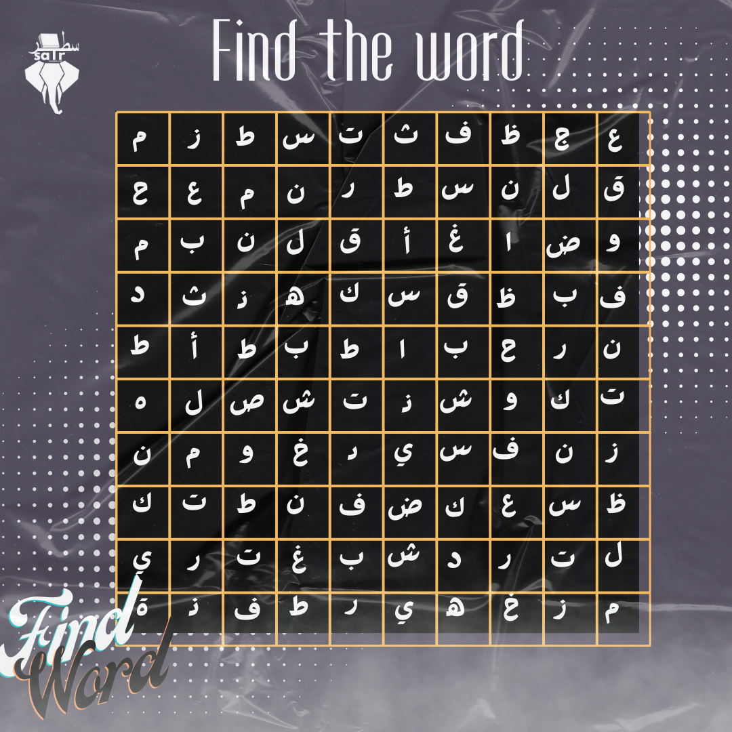

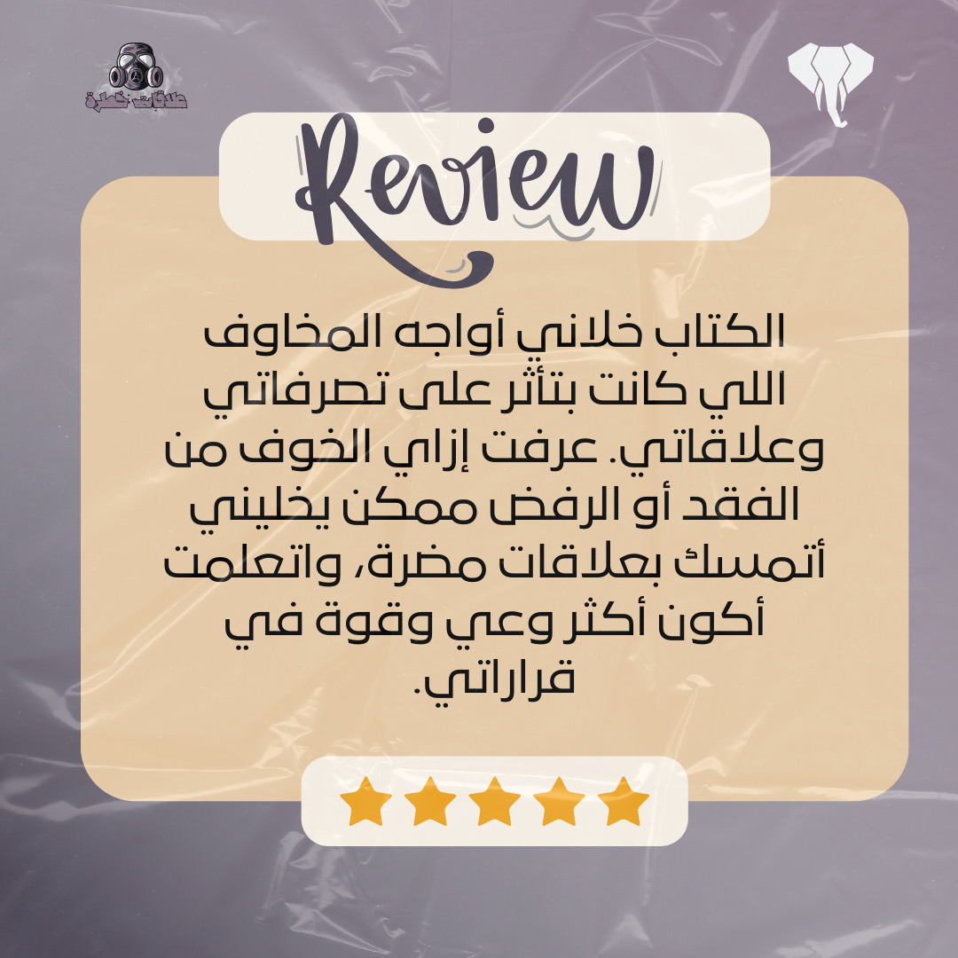
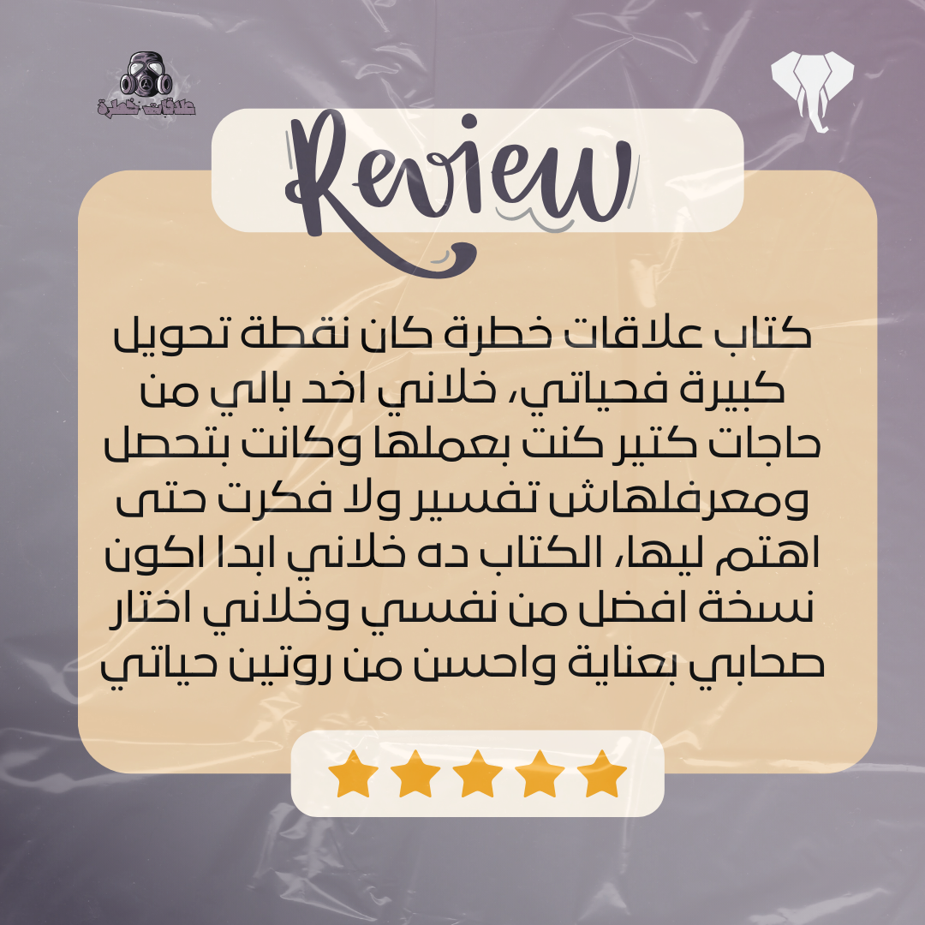
Content visuals

Slide 26


Content visuals

Slide 27
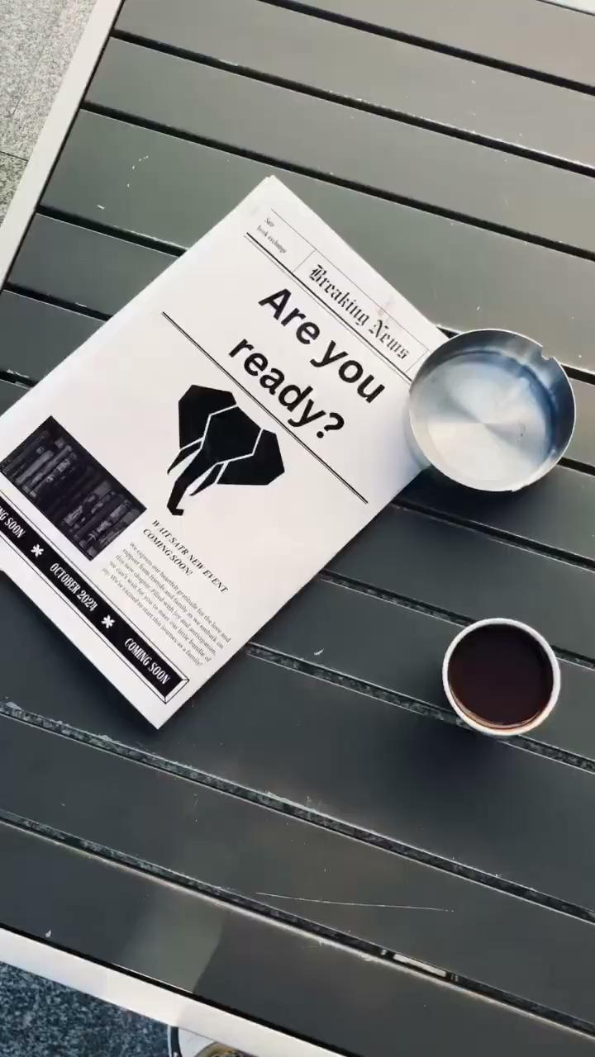
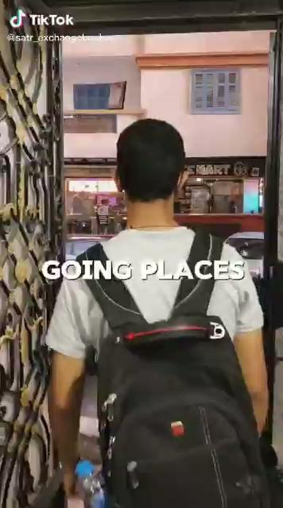

Slide 28
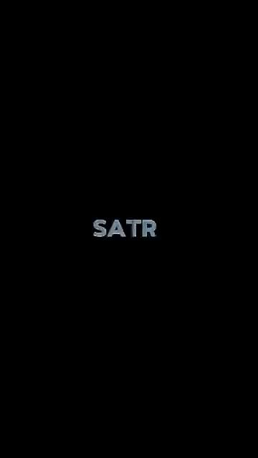
Paid Ad: Campaign overview :
The ad settings :
Objective : Traffic
The link : The book club register link
Our budget : 1000 EGP
Ad platform : Facabook
Conversion : To messaging app
Audience demographics :
Suez governorate within 20 kilos
All genders
Detailed targeting : Suez university / books / Reading / family and friends
CTA : Buy tickets

Slide 29
campaign overview :
leads : 20 leads
Total Clicks: 91
Click-Through Rate (CTR): 1.32
Cost Per Click (CPC): 1.97 EGP
Impressions and Reach: 6.871 impressions

Slide 30
Our campaign : organic results

Slide 31
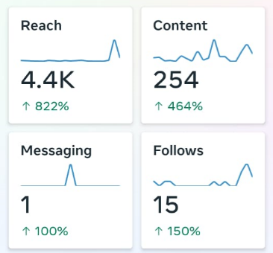
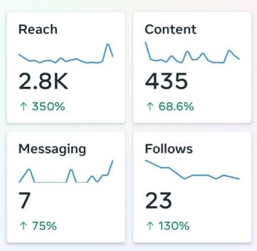
Organic results
Facebook :
about 100 %increase in likes per post
822 % increase in reach
new 15 follower (150 % increase)
Instagram :
New 23 follower (130 % )
350 % increase in reach
75% increase in messaging
increase 171 % in likes per post

Slide 32
Recommendations:
Content and Engagement:
Start a Book Challenge: Create a monthly or seasonal reading challenge with themes. For example, a "Classic November" challenge where participants read and discuss classic literature, or a "New Year, New Genre" to explore books outside their comfort zone.
Weekly Book Discussions: Host weekly online discussions or live sessions where members can discuss a specific book. Encourage active participation with conversation starters and open-ended questions to engage the audience deeply.
User-Generated Content: Encourage members to share their book reviews, favorite quotes, or book photos using a unique hashtag. Feature the best submissions on the SATR Book Club's social media.
Campaign Strategy:
Email Marketing: Create a weekly or monthly newsletter with book recommendations, summaries of past discussions, upcoming events, and engaging content (like “Top 5 books for a rainy day”).
Milestone Celebrations: Celebrate campaign or club milestones, like “15 Members Joined” or “10 Books Reviewed,” with special events or discounts. This can create a sense of accomplishment and encourage further participation.
Book Swaps and Meet-ups: Organize physical or online book swap events where members can trade books they've finished with others. This can be a great way to engage the local community and promote reading.

